Slide 1

Team Arcanine Presents
A Comprehensive Analysis of the original 151 Pokémon
Adwoa Darkwa-Anto, Nancy Sakyi, Azkya Said, Dustin Shaddix

Slide 2
Project Overview
We conducted an in-depth analysis of the 151 original Pokémon listed in the Pokedex. Our objective was to gather and analyze data on various aspects, such as the distribution of Pokémon types, identifying the strongest and weakest Pokémon, determining the fastest and slowest Pokémon, assessing the legendary Pokémon, and examining correlations between different Pokémon stats.
Through this comprehensive analysis, we aimed to gain valuable insights into the underlying design philosophy behind the creation of the original 150 Pokémon and ultimately determine the most powerful Pokémon among them.
We were able to gather this data by a mix of PokeAPI and various CSV files containing the data that we needed.

Slide 3
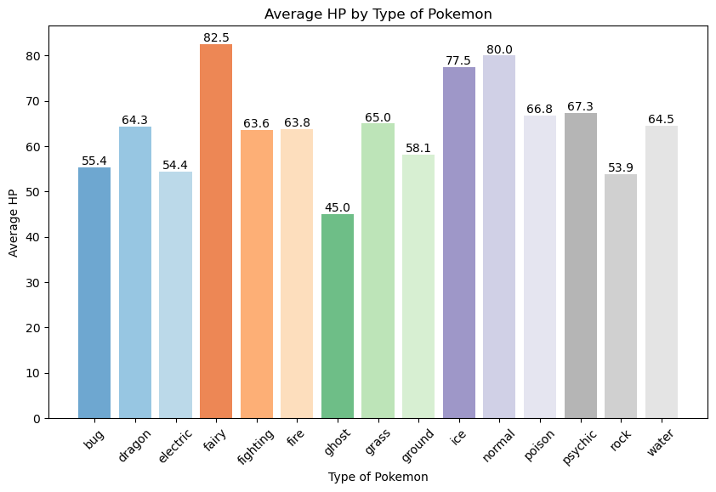
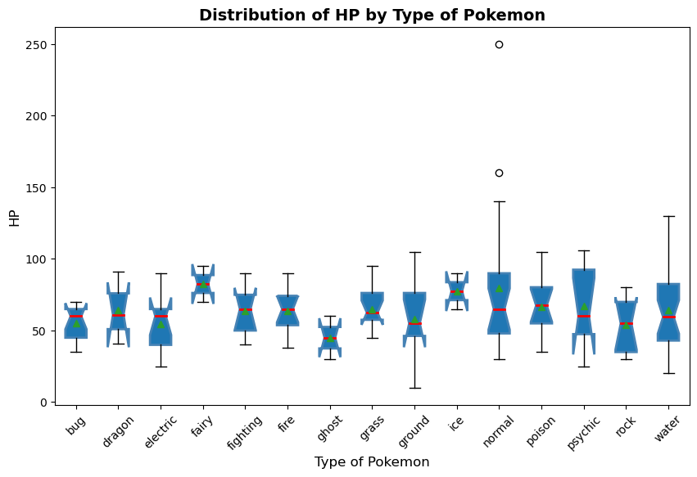

Average HP by Type Of Pokémon

Slide 4
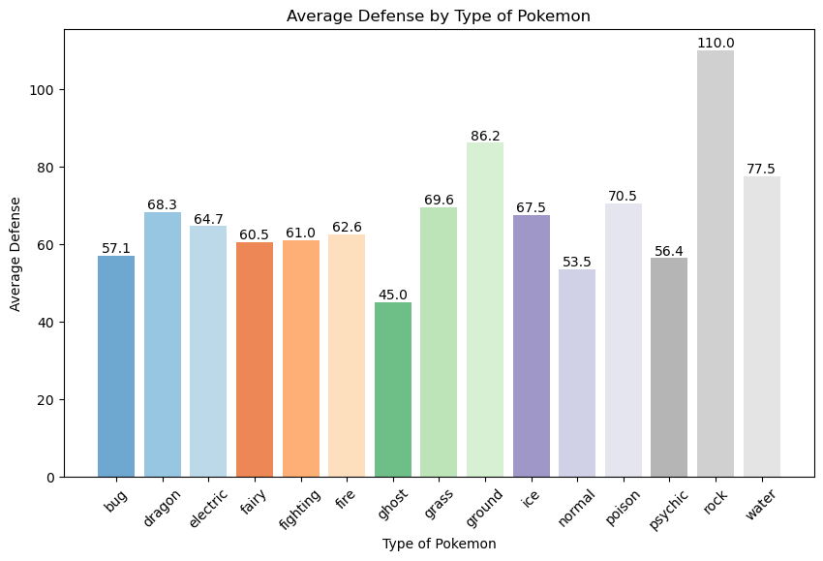

Average Defense by Type Of Pokémon

Slide 5

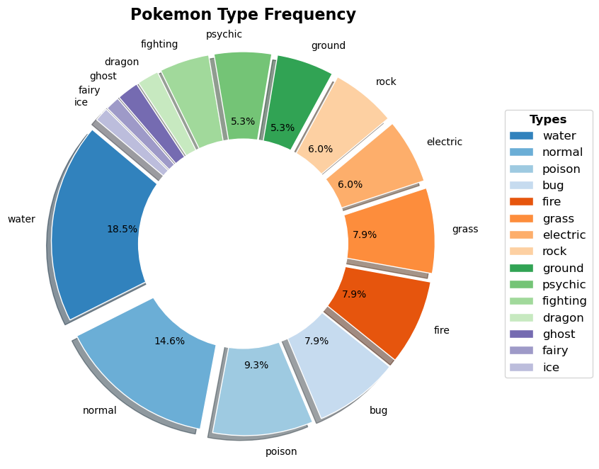
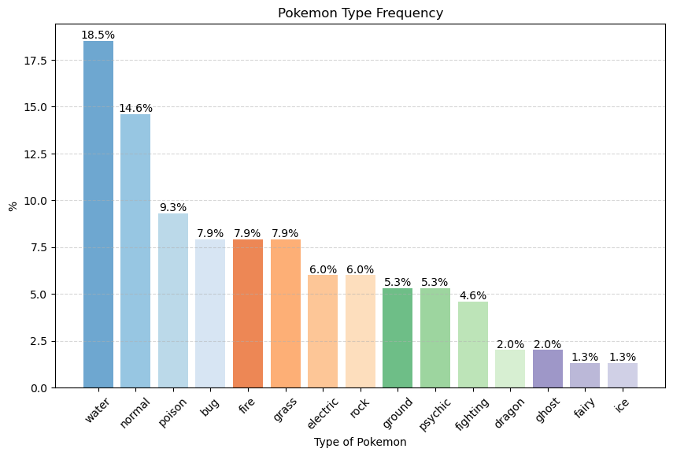
Pokémon Frequency by Type

Slide 6

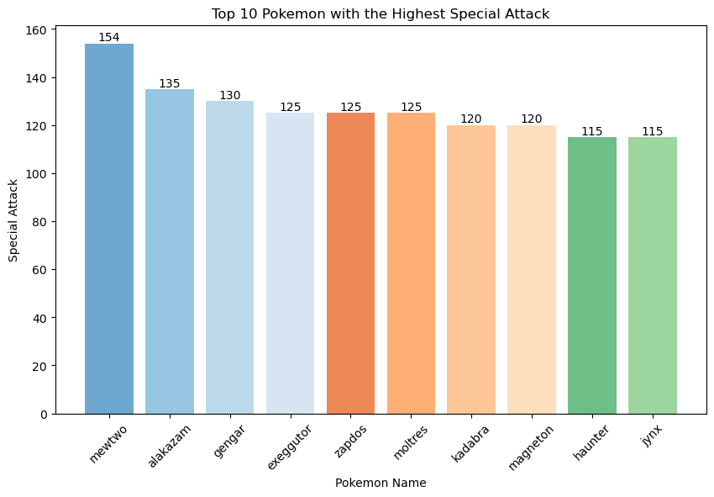
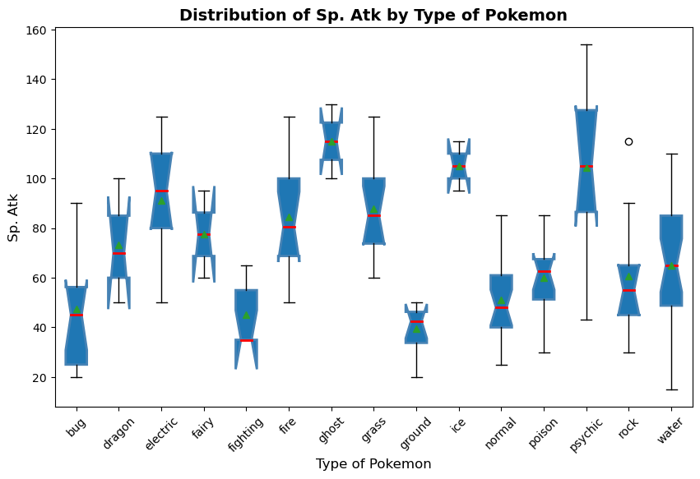
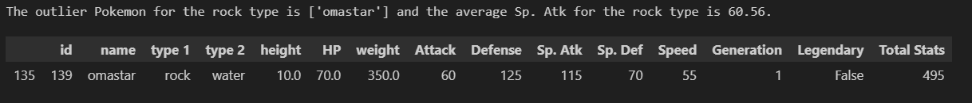
Highest Special Attack

Slide 7

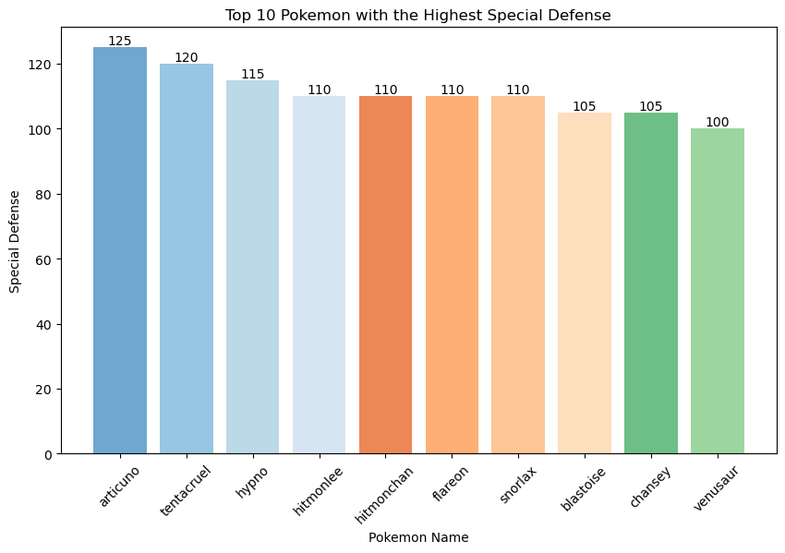
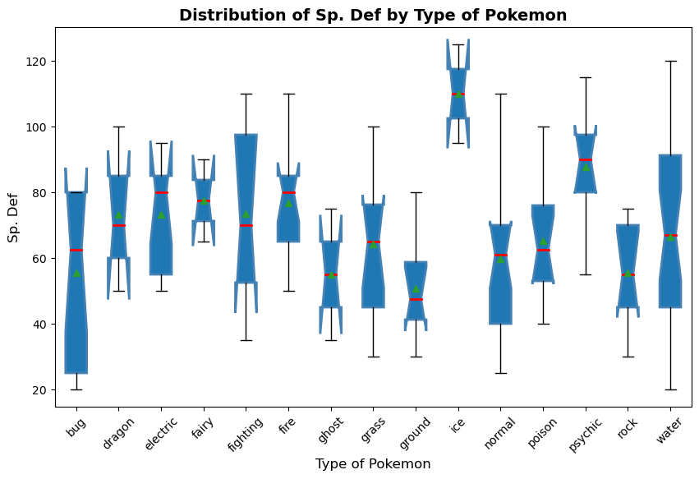
Highest Special Defense

Slide 8
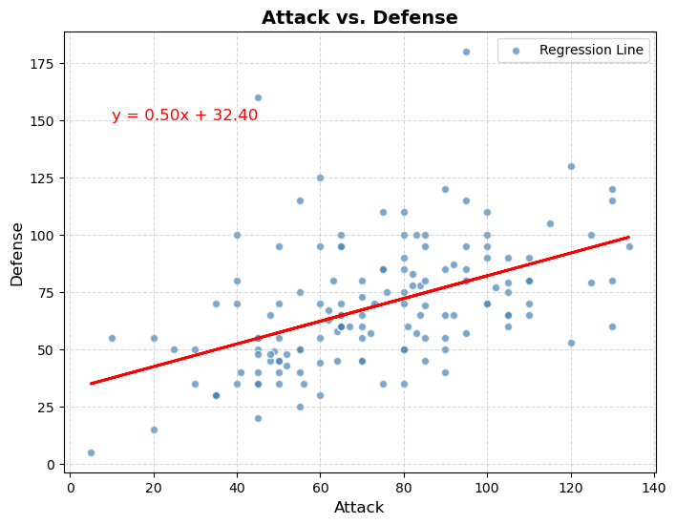
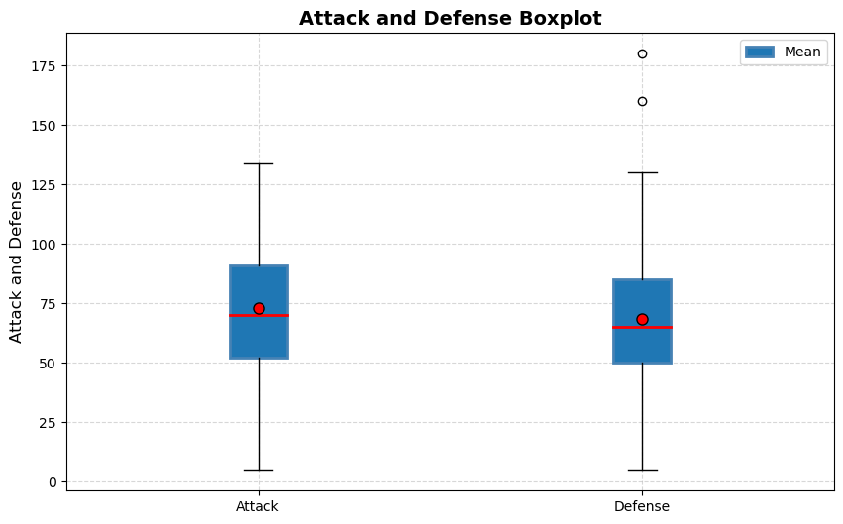
Correlation of Attack and Defense
Notes:
Correlation coefficient (r^2): 0.49

Slide 9

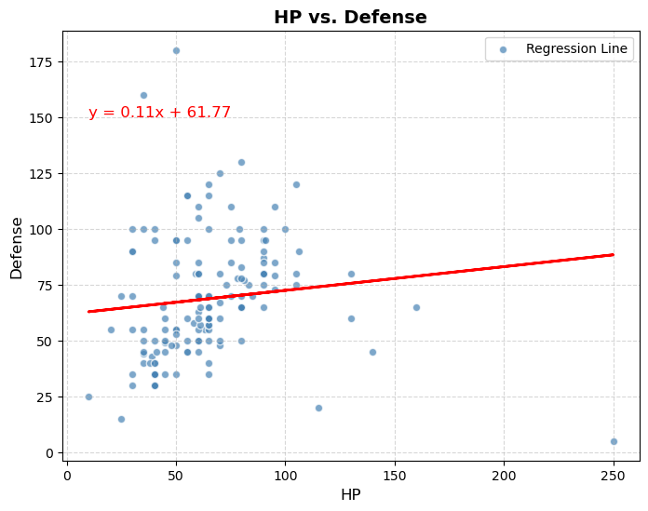
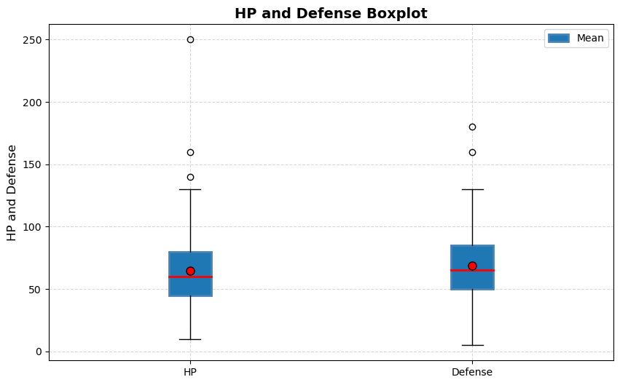
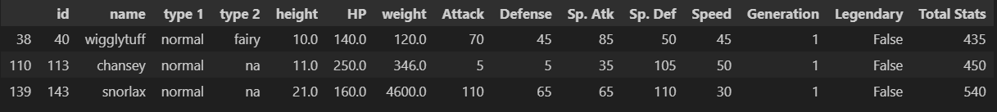
Correlation of HP and Defense
Notes:
Correlation coefficient (r^2): 0.11, outliers are for defense

Slide 10

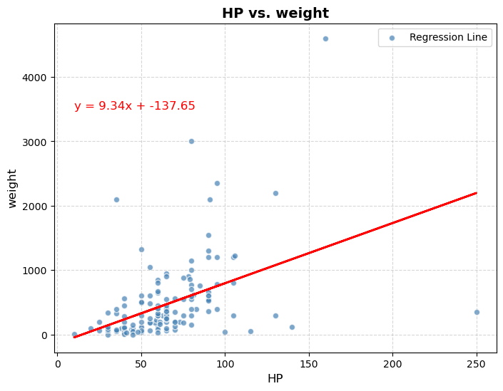
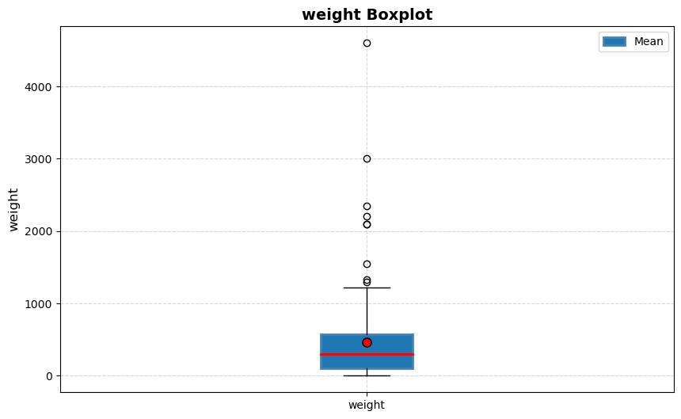
Correlation of HP and Weight
Notes:
Correlation coefficient (r^2): 0.45 between HP and weight

Slide 11
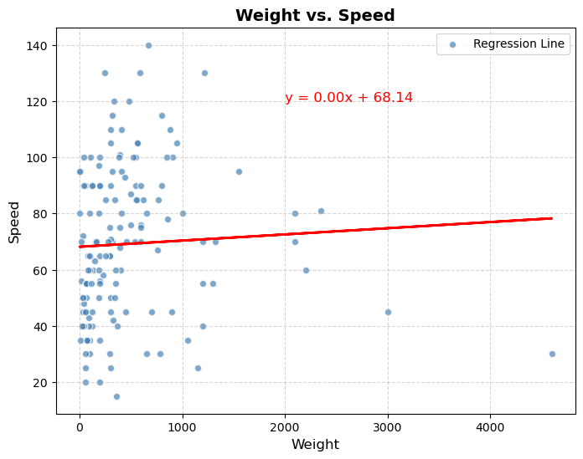
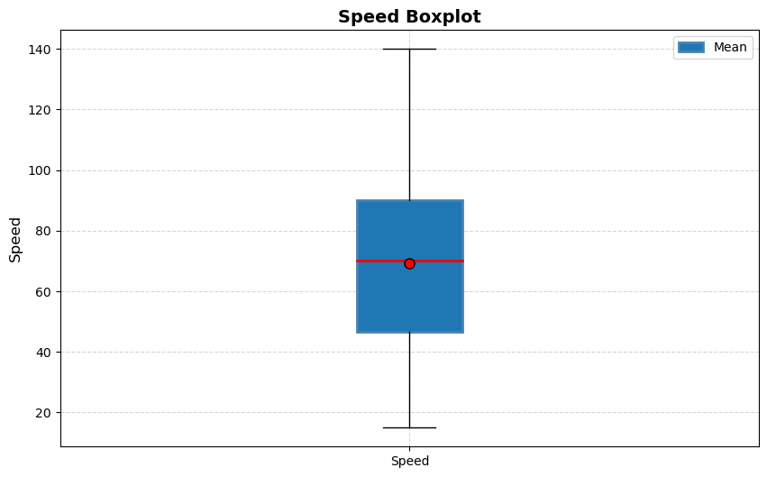
Correlation of Weight and Speed
Notes:
Correlation coefficient (r^2): 0.05 between speed and weight little to no correlation between weight and speed

Slide 12
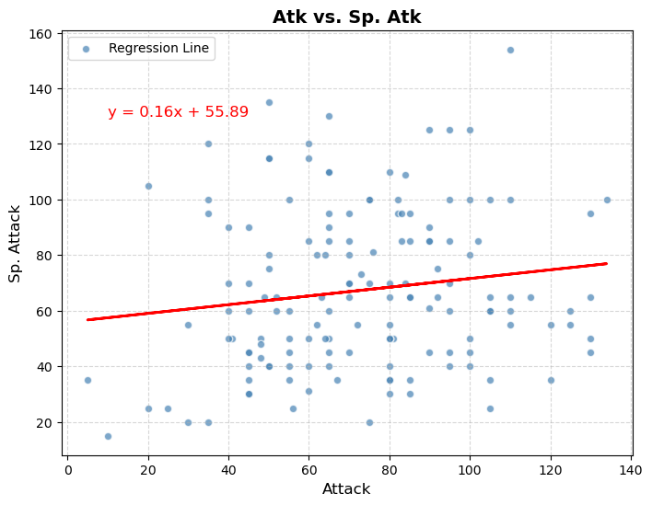
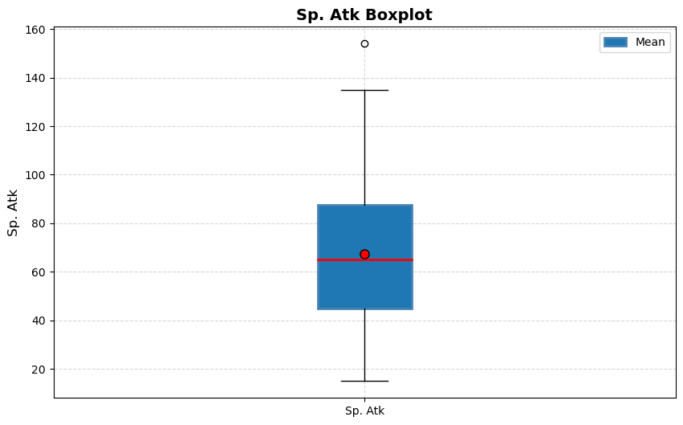
Correlation of Attack and Sp. Attack
Notes:
Correlation coefficient (r^2): 0.15 between Attack and Special Attack, outliers are for Sp attack

Slide 13


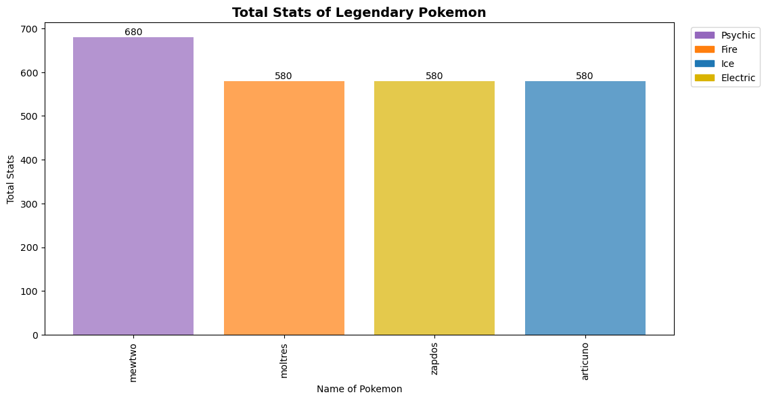


Legendary Pokémon and their Stats

Slide 14
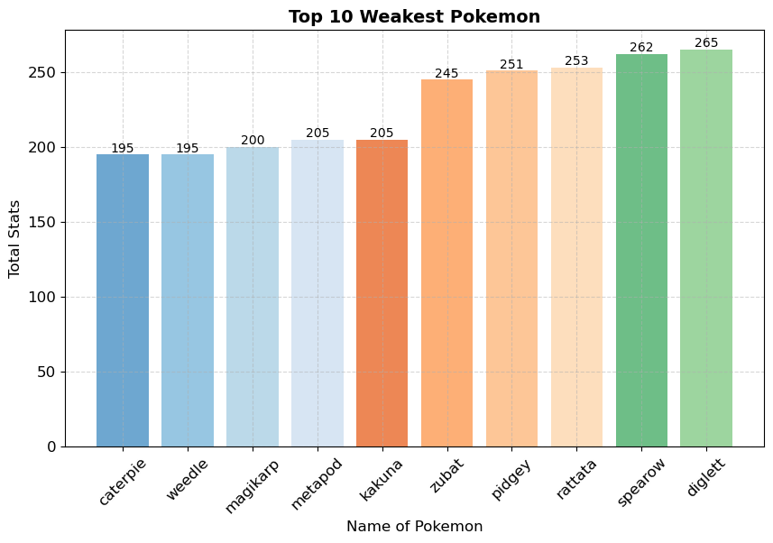

Weakest Pokémon and Their Stats

Slide 15

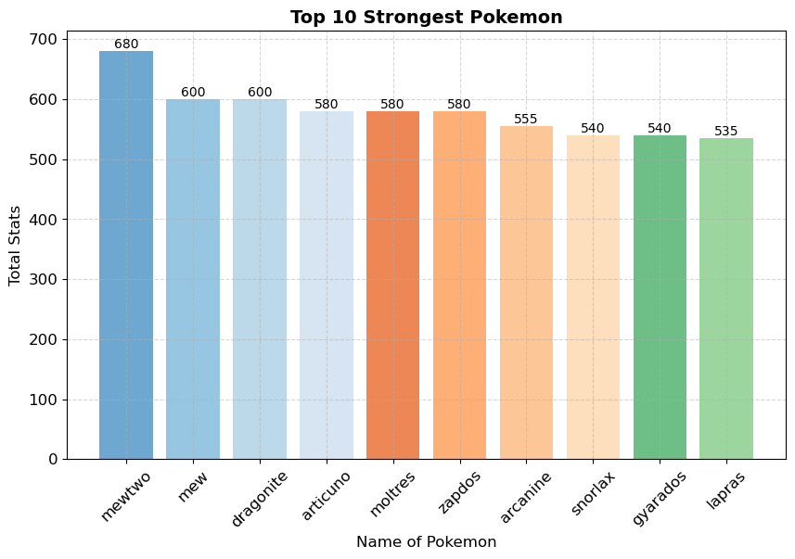

Strongest Pokémon and Their Stats

Slide 16
Conclusion
In analyzing the original 151 Pokémon and their corresponding stats, it becomes evident that a tier system was seemingly employed during their creation. Unlike the newer generations of Pokémon, these early cards lacked the inclusion of "abilities," resulting in certain Pokémon being inherently superior to others. Consequently, possessing these advantageous cards in one's deck would often create a significant disparity that was challenging to overcome.
In the original 151 Pokémon set, the cards' statistics remained fixed, with no means of alteration or enhancement. Consequently, some Pokémon inherently possessed superior attributes compared to others. Contrasting these cards with those from later generations reveals distinct disparities, as newer cards introduced the concept of "abilities" and other special modifiers that could transform seemingly unremarkable cards into formidable contenders. This addition has consequently introduced a newfound level of freedom, gameplay dynamics, and deck-building strategies.
Upon examining the original 151 Pokémon alongside their contemporary counterparts, it becomes evident that the former represents a more rudimentary form of the game. The subsequent generations of Pokémon have progressively introduced complexity, marked by the inclusion of abilities, resulting in the game “evolving” over time.

